Slide 1
Accessibility in Practice
What do we mean when we talk about accessibility?
Green Accessibility | David Proffitt March 10, 2014

Slide 2
What is accessibility?
How do we plan for accessibility?
What is the difference between accessibility & mobility? (Is there one?)
How do we measure accessibility?
How do accessibility measures affect transportation planning?
Green Accessibility |David Proffitt March 10, 2014

Slide 3
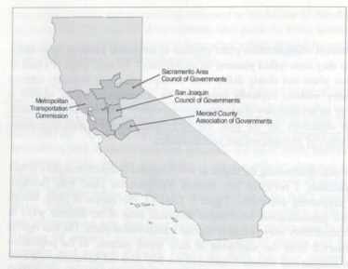
Accessibility in transportation planning
A review of regional transportation plans in California (MTC, SACOG, SJCOG, MCAG) found a mixed picture:
Main focus on mobility
Emerging focus on accessibility
Accessibility measures not always labeled as such
Handy, S. (2005). Planning For Accessibility: in Theory and in Practice. In D. M. Levinson & K. J. Krizek (Eds.), Access to Destinations (pp. 131–147). Oxford, UK: Elsevier.
Green Accessibility | David Proffitt March 10, 2014

Slide 4

Mobility vs. accessibility
Mobility: “In the context of transportation planning, mobility has been defined as the potential for movement, the ability to get from one place to another, an ability to move around.”¹
Accessibility: “Accessibility can be thought of as an ability to get what one needs, if necessary by getting to the places where those needs can be met.”¹
¹(Handy, 2005)
Green Accessibility | David Proffitt March 10, 2014
Notes:
This is the difference between movement and opportunity, capacity and potential. There is a scale difference between the two concepts. Accessibility encompasses mobility, but not the other way around.
I think it’s too bad we use the same word to describe ADA compliance and the ease of getting to places we need to go. The similarities make it too easy to conflate accessibility with “alternative” transportation modes such as transit. Thinking of it this way limits the scope of the concept to providing for people who don’t drive rather than making it easier for everyone to accomplish daily needs and tasks (instead of just making travel easier for the people who choose to drive).

Slide 5
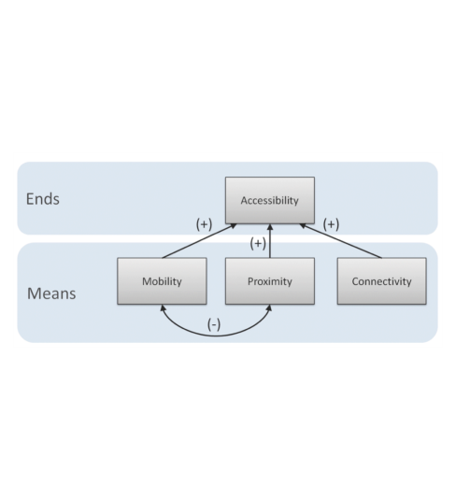
Accessibility is goal of travel
Transportation is a “derived demand” – we travel to accomplish things, not just to move
Increasing automobile mobility (speed) often decreases proximity of destinations = lower accessibility
Mobility focuses on system (means); accessibility focuses on individual (ends)
Balance between mobility and accessibility depends on performance measures
Graphic from: Levine, J., Grengs, J., Shen, Q., & Shen, Q. (2012). Does Accessibility Require Density or Speed? Journal of the American Planning Association, 78(2), 157–172. doi:10.1080/01944363.2012.677119
Green Accessibility | David Proffitt March 10, 2014
Notes:
Another way to approach accessibility is as the mediator between environment and behavior. Whether one walks around the corner to a shop, drives across town to see a move, or teleconferences in to a work meeting, all these locations are accessible.
Traveling farther and faster *can* increase accessibility to destinations, but not necessarily. If we focus only on automobile mobility, we will continually bump up against the limits of our capacity to build new roads – and create places where the only possible means of getting around is by automobile. We are guaranteed to fail if we do this. To break out of the vicious cycle of more and more “congestion relief” leading to ever more dispersed destinations, we can focus on helping people conduct their business in multiple ways – giving them choice – rather than forcing them to drive or forgo an opportunity.

Slide 6
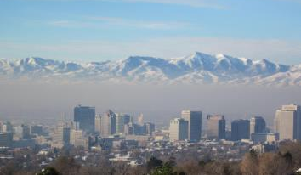
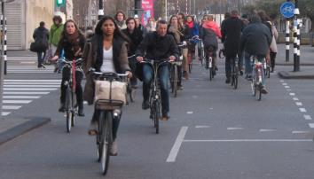
Implications for planning
Planning for individual needs (accessibility) over system performance (mobility) could change outcomes:
Lower VMT = better air quality
Greater proximity = reduced land consumption
Easier job access @ lower cost = higher employment, lower poverty
Higher compactness = potentially lower infrastructure costs
Green Accessibility | David Proffitt March 10, 2014

Slide 7
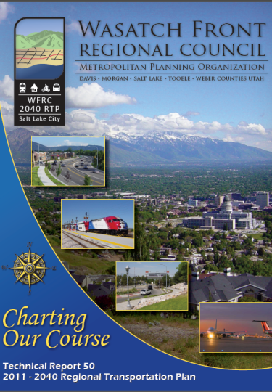
Accessibility in Utah
WFRC 2011-2040 RTP mentions accessibility in different ways:
As a goal: “increasing mobility and accessibility”
As a synonym for expanded transit: “In addition to improving traffic mobility, the RTP will provide increased accessibility to transit” (p. 253).
As a byproduct of road/highway capacity: “The roadway and transit improvements recommended in the 2040 RTP will help reduce area congestion and enhance accessibility” (p. 282).
“Urban form can favor one mode over others and may influence overall number of vehicle miles traveled by changing the cost of such travel. … The nature of the transportation network can influence the directness or indirectness of travel routes while the pattern of development can influence the viability of transit and other modes and the length of trips. Urban form influences accessibility, which is unquestionably a factor in travel behavior” (p. 30).
Green Accessibility | David Proffitt March 10, 2014
Notes:
Mixed picture similar to CA MPOs. Three of five occurrences of “accessibility” in overview comes as part of phrase “mobility and accessibility.” Accessibility is never defined explicitly.
However, RTP is very explicit about the relationship between urban form, mobility, and accessibility.

Slide 8
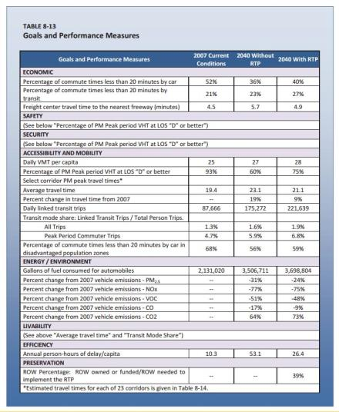
Accessibility measures
“What gets measured, gets done”
- Peter Drucker (?)
Which of these metrics (from the WFRC 2011-2040 RTP) measure accessibility and which measure mobility?
Nearly all look to vehicle speed or movement
Total emissions is exception
Per capita, HH?
Per job, unit economic output?
Green Accessibility | David Proffitt March 10, 2014
Notes:
Work trips are a small proportion of overall travel, yet most performance measures focus on commute times. Familiar refrain, but it bears repeating.
What if we focused on ways to make majority of daily tasks more accessible? If you could walk, bike, take transit, telecommute, or just drive shorter distances to lunch, shopping and errands, how would that change commute trips? Would fewer people need to drive to work every day?

Slide 9
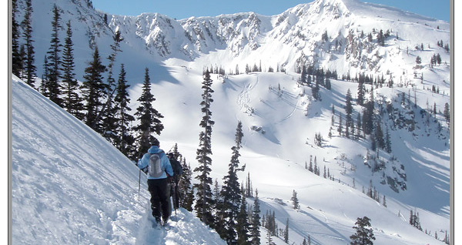
Questions:
Is accessibility a concern to you as a planner?
What type of information would be helpful to incorporate accessibility into planning efforts?
How would you make use of accessibility measures in planning?
What type of tools would help you consider accessibility in planning?
Green Accessibility | David Proffitt March 10, 2014
Notes:
Thinking about where people want to go and what they want to do there gives us a very different frame of reference than thinking only about the performance of our road network.
Backcountry skiing near Mt. Olympus (I think so, anyway!).

